Slide 1
CLUSTERING NEIGHBORHOOD FOR A NEW RESTAURANT
CAPSTONE DATASCIENCE PROJECT

Slide 2
INTRODUCTION
This project is a part of the Capstone Data science course which is used to assess a real-world problem.
This presentation includes the methods, analysis and the results of the study.

Slide 3
PROBLEM STATEMENT
We will be studying the location data of a place in order to know its suitability for opening a new restaurant. Specifically, this report will be targeted to stakeholders interested in opening an restaurant in Toronto, Canada.

Slide 4
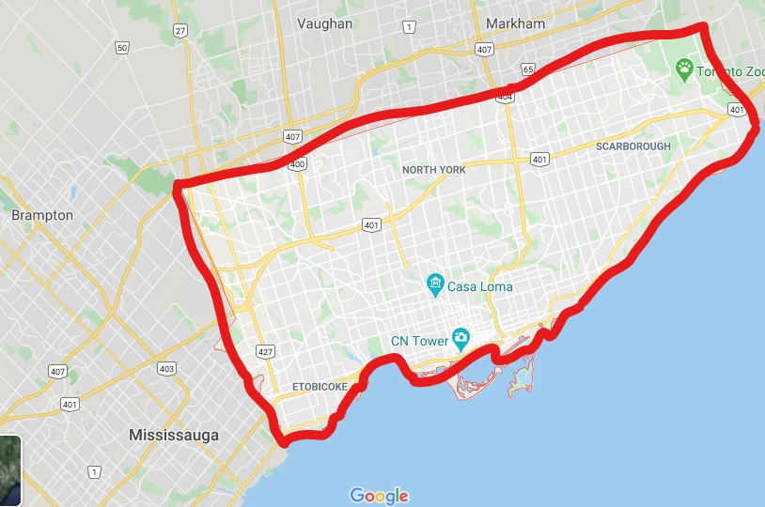
TORONTO
Toronto is the provincial capital of Ontario.
Toronto is an international centre of business, finance, arts, and culture, and is recognized as one of the most multicultural and cosmopolitan cities in the world.
The diverse population of Toronto reflects its current and historical role as an important destination for immigrants to Canada.

Slide 5
DATA DESCRIPTION
Following data sources will be needed to extract/generate the required information:
Centers of candidate areas will be generated algorithmically and approximate addresses of centers of those areas will be obtained using
https://en.wikipedia.org/wiki/List_of_postal_codes_of_Canada:_M
Number of restaurants in the neighborhood and their type and location will be obtained using Foursquare API

Slide 6
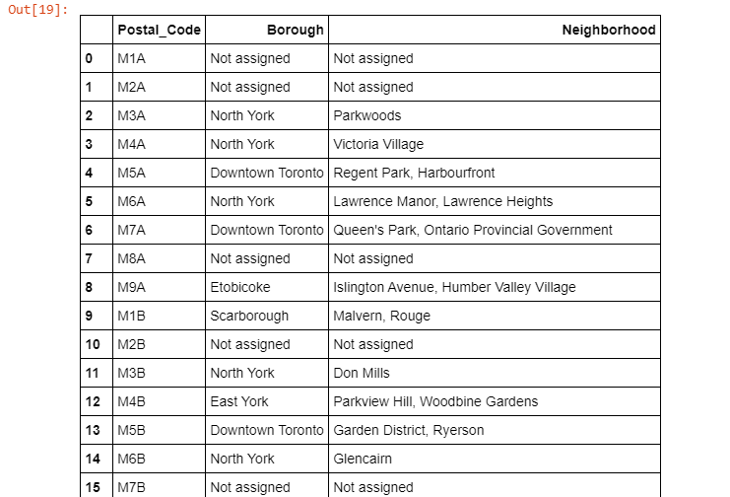
Acquiring of Data
The first step in our analysis is to capture the Data source from the required Locations.
Here we are using 2 datas, one from Wikipedia and the other from FoursquareAPI. The data about the postal codes of Canada is obtained from Wikipedia by the help of a library package named as 'BeautifulSoup'.
Then the obtained Dataset is saved into a dataframe with three columns: Postal Code,Borough and Neighborhood. The dataframe is given here.

Slide 7
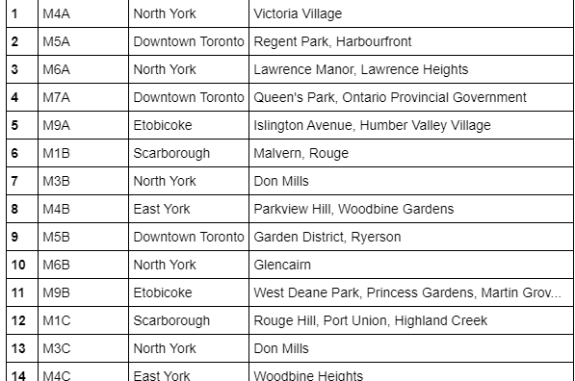
Data Cleaning
The data is cleaned for any redundant value and the cleaned dataframe is shown here.

Slide 8
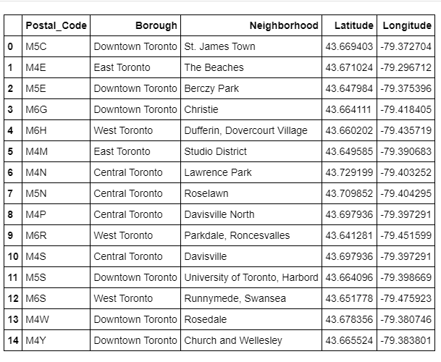
COMBINING DIFFERENT DATA SOURCE AND SORTING NEIGHBORHOOD BASED ON LONGITUDE AND LATITUDE
The latitude and Longitude Data are obtained in the same way as the postal code data using a link.
This data is also converted into a data frame and this data is merged along with the previously formed data frame. The figure is shown here.

Slide 9
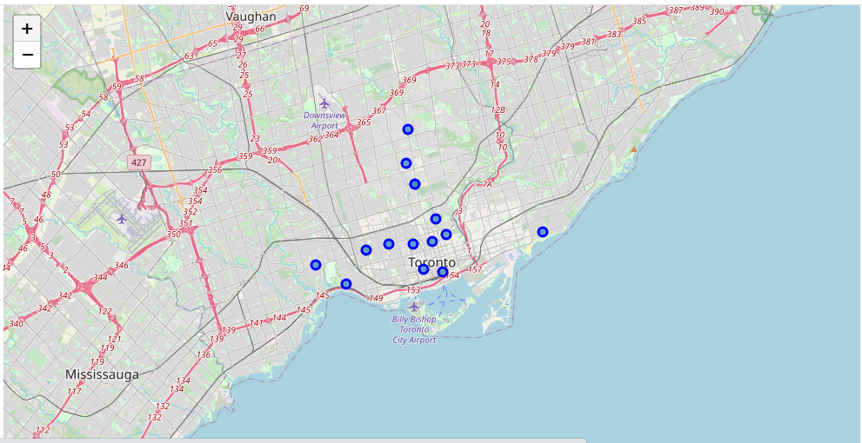
EXPLORE THE TORONTO'S NEIGHBORHOODS
sdhlisugalrkjbgae

Slide 10
EXPLORING TORONTO’S NEIGHBORHOODS
Firstly, we explored all the neighborhoods in the city of Toronto, using the Latitude & Longitude data, using Foursquare API to get the Restaurant venues available in Toronto.
The dataset is cleaned to get the unique venues for each Neighborhood.
The Neighborhood deduced is then visualized using the Folium tool.

Slide 11
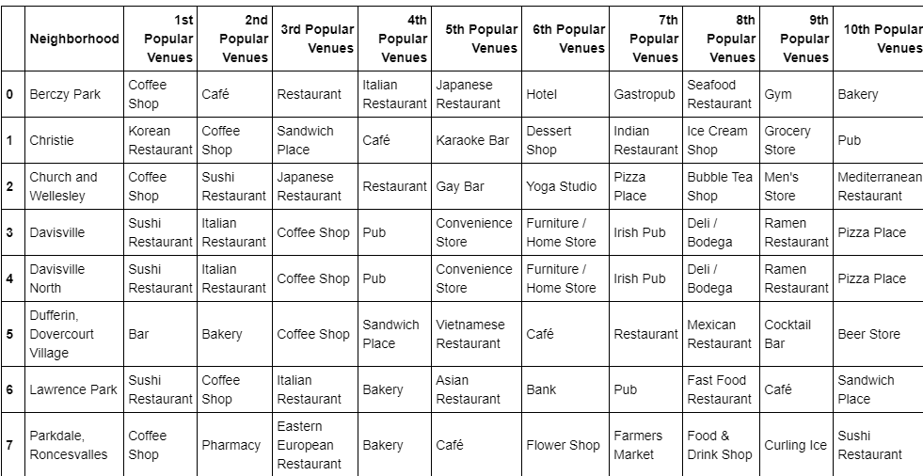
CLUSTERING
We are clustering the city of Toronto into a cluster of five. That is the value of k will be 5.
Now we use the K-Means Clustering to come up with 5 clusters in Toronto woth similar set of venues. We are going to explore each cluster based on various factors to differentiate the discriminating venue categories that explicitly differentiate each cluster.
The Neighborhoods with the maximum number of Restaurants in their surrounding will be selected for further exploration.

Slide 12
K-MEANS CLUSTERING
K-means clustering is a type of unsupervised learning, which is used when you have unlabeled data (i.e., data without defined categories or groups).
The goal of this algorithm is to find groups in the data, with the number of groups represented by the variable K.
The algorithm works iteratively to assign each data point to one of K groups based on the features that are provided. Data points are clustered based on feature similarity.
The results of the K-means clustering algorithm are:
The centroids of the K clusters, which can be used to label new data Labels for the training data (each data point is assigned to a single cluster)

Slide 13
RESULTS AND DISCUSSIONS
We have 4 boroughs and 74 neighborhoods inside geograpical coordinate of 43.653963, -79.387207.
Based on our initial assumption of the cluster with maximum number of restaurants will have the best possibility to have a new restaurant due to the need in the area.
Based on the resultant clusters it looks like Cluster 1 and Cluster 5 have higher number of resturants then rest of the clusters.

Slide 14
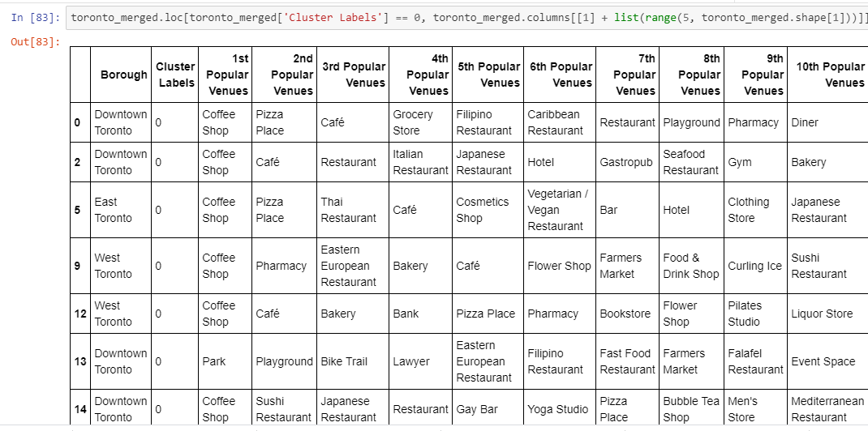
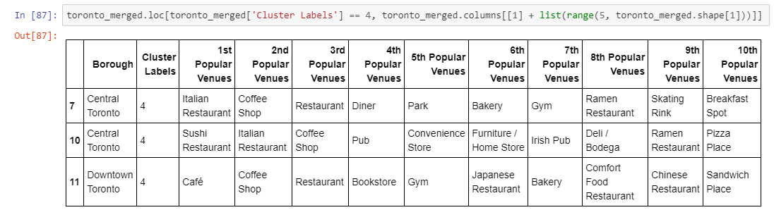
CLUSTERS THAT HAVE POTENTIAL FOR FURTHER ANALYSIS
CLUSTER 5
CLUSTER 1

Slide 15
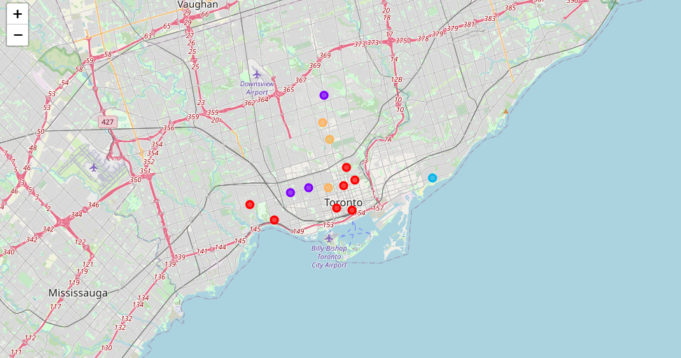
MAP OF TORONTO WITH CLUSTERED NEIGHBORHOODS

Slide 16
CONCLUSION
The final decision id in the Stakeholders and it is based on the Data scientist’s report and also putting into concern the following points:
The final decision on the location will be in the hands of the stakeholders and this decision is based on various characteristics as follows:
The levels of noise. For example the restaurant should not be in a place where the customers cannot eat in peace.
THe proximity to the major roads so that is easily commutable
THe real estate availability
The attractiveness of the Location. The location of various trending hotspots and tourist places will welcome a lot of population on a daily basis.
Prices, Social and Economic dynamics of every Neighborhood.
The availability of resources such as water also plays important role.

